Slide 1

Mini Project-I (K24MCA18P) Odd Semester Session 2024-25
MindMaze
Team Leader: Ridhi Rajput (2426MCA334)
Member: Roopsi Srivastava (2426MCA696)
Project Supervisor:
Ms. Divya Singhal
Assistant Professor

Slide 2

Content
Introduction
Sustainable Development Goal
Literature Review
Objective of the Project
Technology
Hardware Requirements
Software Requirements
Modules
Workflow
Reports
References
Notes:
Font Styles: Times New Roman + Font Size: 25

Slide 3

Introduction
Welcome to MindMaze, a dynamic platform designed to offer interactive quizzes and games focused on computer science, logical ability, and quantitative aptitude. Our goal is to provide a fun and engaging learning experience for students, learners, and enthusiasts who are looking to sharpen their skills in these areas. Whether you want to challenge your mind, our platform offers a variety of quiz formats and games to help improve critical thinking. We aim to make learning both enjoyable and educational, ensuring that users enhance their skills in a practical and interactive way.
Notes:
Font Styles: Times New Roman + Font Size: 25

Slide 4

SUSTAINABLE DEVELOPMENT GOAL
Our website will likely contribute to Sustainable Development Goal 4 (SDG 4): Quality Education.
SDG 4 aims to ensure inclusive and equitable quality education and promote lifelong learning opportunities for all. Since our website offers quizzes and games related to computer science, logical ability, and quantitative aptitude, it aligns with this goal by providing educational resources that enhance learning and critical thinking.

Slide 5
Literature Review
1. Quizzes for Knowledge Retention
Long-term retention
Self-assessment and progress tracking
2. Games for Cognitive Development
logical thinking and problem-solving
engagement
Notes:
Font Styles: Times New Roman + Font Size: 25

Slide 6
Literature Review (Contd.)
Improve mathematical reasoning through games
Enhances speed and accuracy in problem-solving
3. Quantitative Aptitude
4. Blended Learning Approach
Combining quizzes and games improves practical application
Engages students with immediate feedback and self-paced learning
Notes:
Font Styles: Times New Roman + Font Size: 25

Slide 7
Objective of the Project
Enhance Learning
Provide interactive quizzes and games in computer science, logical reasoning, and quantitative aptitude.
Facilitate Self-Assessment
Offer instant feedback to help users track progress and improve.
Promote Regular Practice
Create a motivating platform for continuous learning and improvement
Boost Problem-Solving Skills
Encourage critical thinking and analytical development
Notes:
Font Styles: Times New Roman + Font Size: 25

Slide 8
Technology
Hardware Requirements
Web Server/
Database
RAM:
Minimum 8 GB
Bandwidth
Minimum of 100 Mbps
Storage:
SSD with sufficient capacity
Processor:
Dual-core or higher
Backup System:
Cloud-based storage
Notes:
Font Styles: Times New Roman + Font Size: 25

Slide 9
Technology
Software Requirements
HTML/CSS
MySQL
Figma
JavaScript
PHP/C++
Notes:
Font Styles: Times New Roman + Font Size: 25

Slide 10

Modules
User Management
Features: User registration, login, profile management.
Quiz Module
Features: MCQs, T/F, Picture and short-answer quizzes.
Game Module
Features: Interactive games focusing on logic puzzles, fun games and math problems.
Functionality: Allow users to create accounts, manage profiles, and track their quiz/game performance.
Functionality: Create and administer quizzes on computer science, logical reasoning, and quantitative aptitude topics.
Functionality: Develop games that engage users in problem-solving activities.
Notes:
Font Styles: Times New Roman + Font Size: 25

Slide 11

Modules (Contd.)
Admin Dashboard
Features: View user statistics, monitor performance, and manage content.
Contact Us
Features: Phone No. and Email ID
Functionality: User will be able to contact for any query or feedback.
Functionality: Provide admin with full control over website functionality and user activity.
Notes:
Font Styles: Times New Roman + Font Size: 25

Slide 12
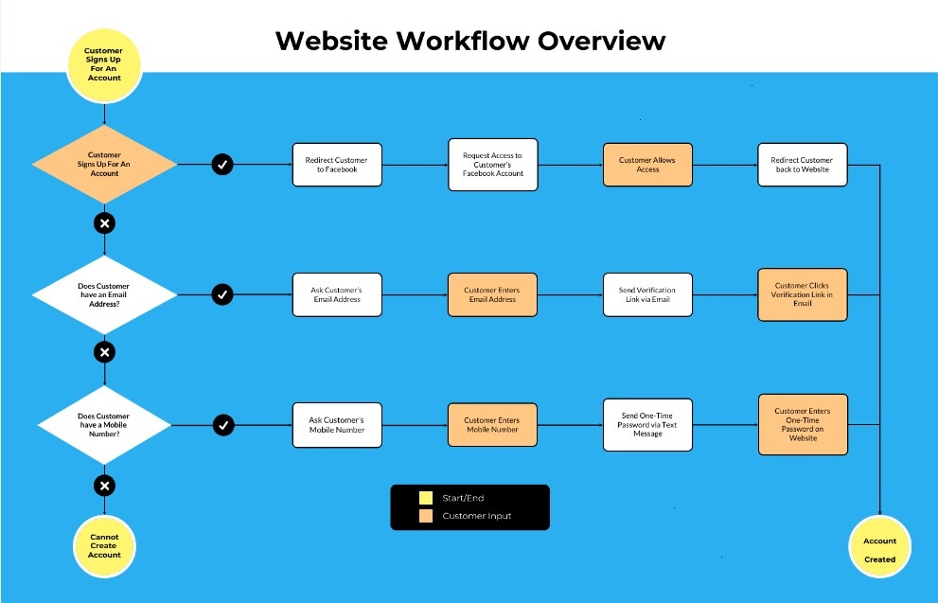
Workflow/Gantt Chart
Notes:
Font Styles: Times New Roman + Font Size: 25

Slide 13

Reports
1. User Engagement
Total Users Registered
Active Users (Last Month)
Daily Active Users
User Retention Rate
3. User Performance Metrics
Average Score
Highest Score
Lowest Score
Top 5 Performers
2. Quiz Participation
Total Quizzes Available
Total Quizzes Attempted
Average Quiz Completion Rate
Most Popular Quiz Topic
4. Feedback and Improvements
User Feedback Received
Average Rating of Quizzes
Suggestions for Improvement
Notes:
Font Styles: Times New Roman + Font Size: 25

Slide 14
References
1.Websites:
Quizlet - A platform for creating and studying quizzes.
Kahoot! - A game-based learning platform for quizzes and interactive learning.
2. For Front End:
https://www.codewithharry.com/
3. For any query:
https://www.google.com/
Notes:
Font Styles: Times New Roman + Font Size: 25

Slide 15

THANK YOU!

